Slide 1
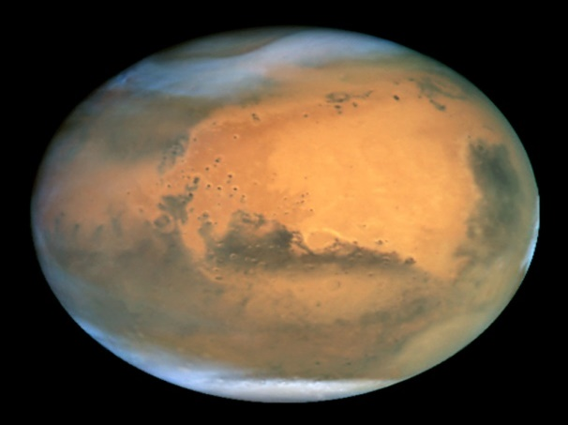



Characterization of Layered Ejecta Blankets in the Southern Hemisphere of Mars
Nathan White
Mentor: Dr. Nadine Barlow
Northern Arizona University

Slide 2
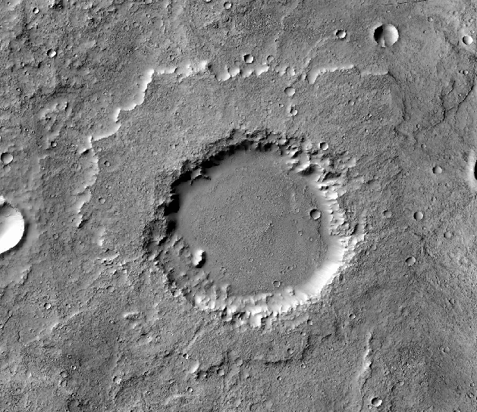
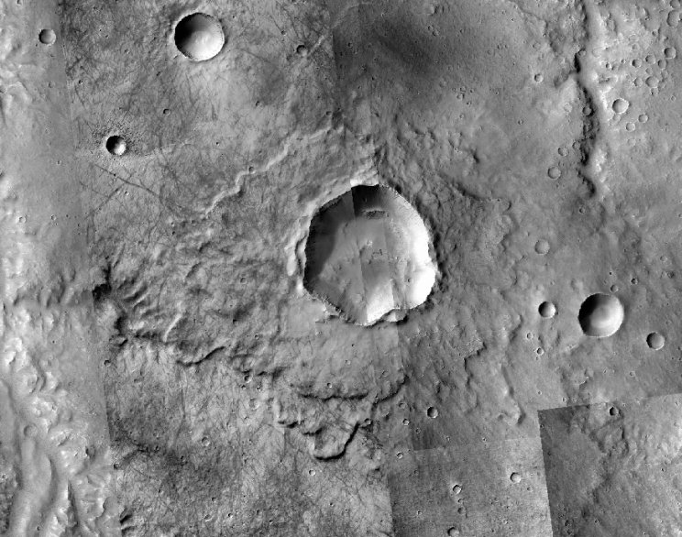
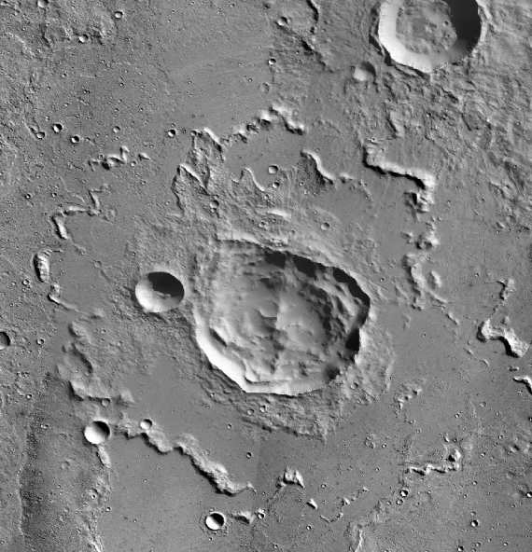
Introduction
Single Layer
Double Layer
Multiple Layer
Notes:
Martian craters normally are surrounded by material called the ejecta blanket. These ejecta blankets fall into three classifications: single layer, double layer, and multiple layer. Single and multiple layer ejecta blankets appear to be the most common, with double layers appearing as a very small minority. Due to project time constraints, we are focusing only on the single layer type ejecta blankets.
WHY THIS IS IMPORTANT: Using the data gained from studying craters, we can determine where the Martian oceans once existed, and the conditions on and below the surface at the time of crater formation.

Slide 3
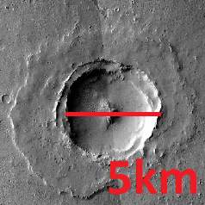

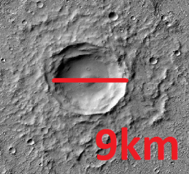
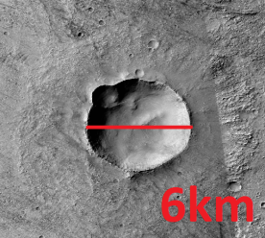
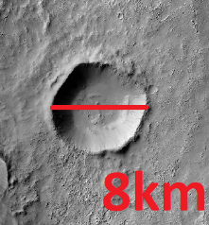
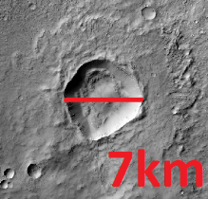
Introduction
Notes:
Due to the composition of the Martian surface or atmosphere at the time of impact, these ejecta blankets are believed to be formed from vaporized ice and not just dry material, and often have the appearance of a “splashed mud puddle.” The sinuosity (muddy appearance) is quantified by what is called “lobateness,” which is a comparison of the ejecta blanket to a circular blanket of the same area. Studying craters in Mars’ southern hemisphere, and comparing the results to the similar studies done in the northern hemisphere, may help us to clear away the uncertainty that exists in the ejecta blanket formation.

Slide 4
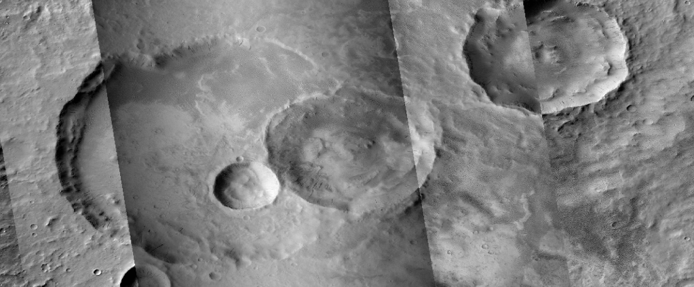
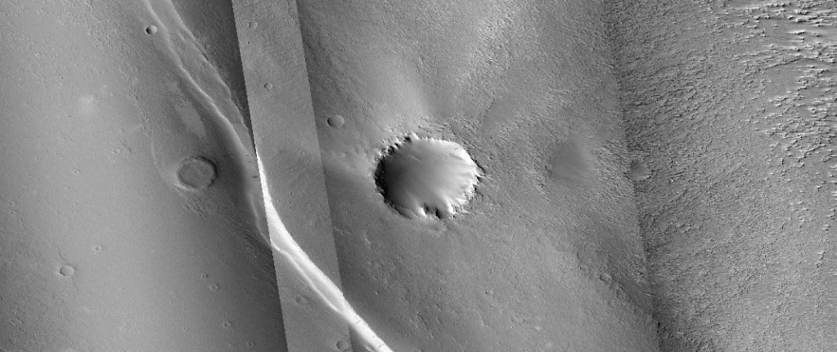
Introduction
Multiple Craters
Eroded
Notes:
Imagery is not always available or useful. Mars’ southern hemisphere is heavily cratered and the surface erosion caused by sand storms often destroy or distort craters’ ejecta blankets.

Slide 5
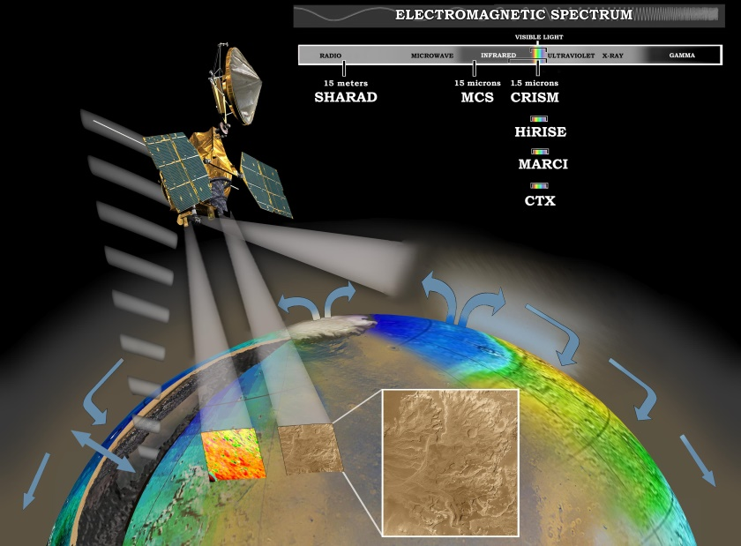
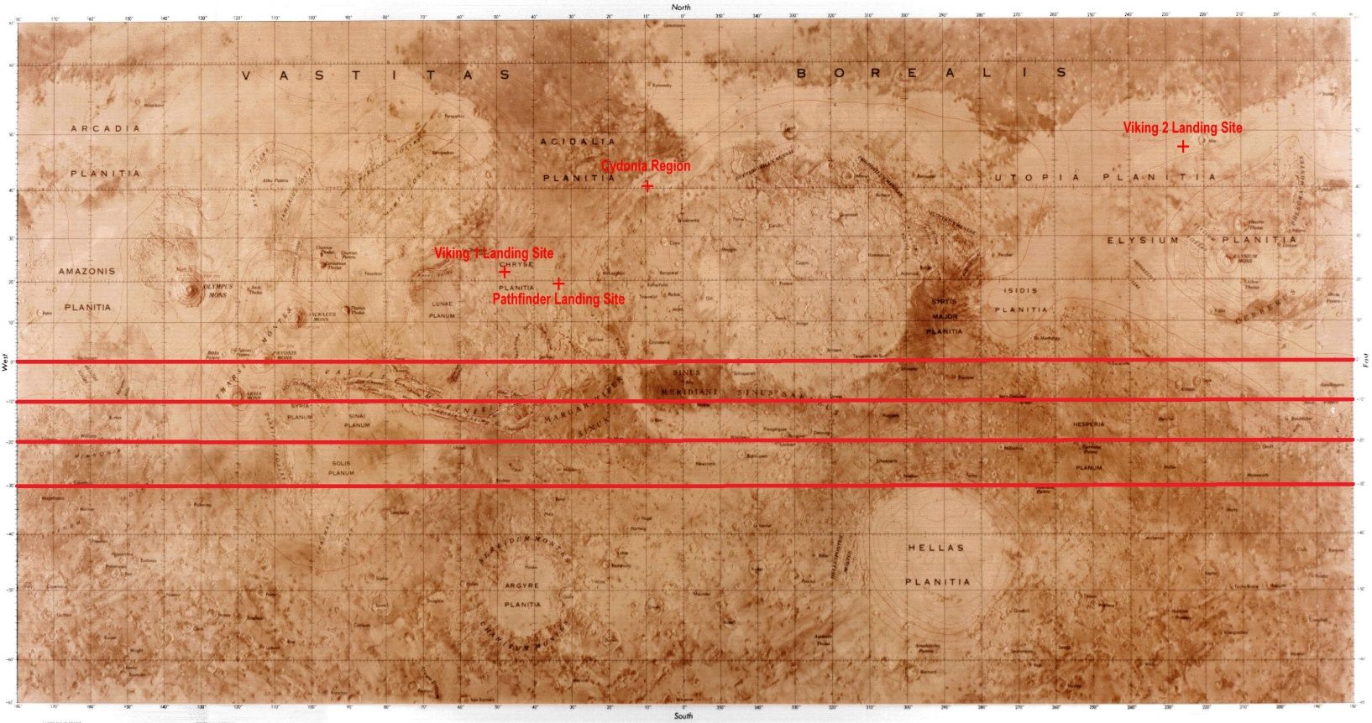
Scope
750+ Craters 133 Usable Images
Mars Reconnaissance Orbiter
Context Camera (CTX)

Slide 6
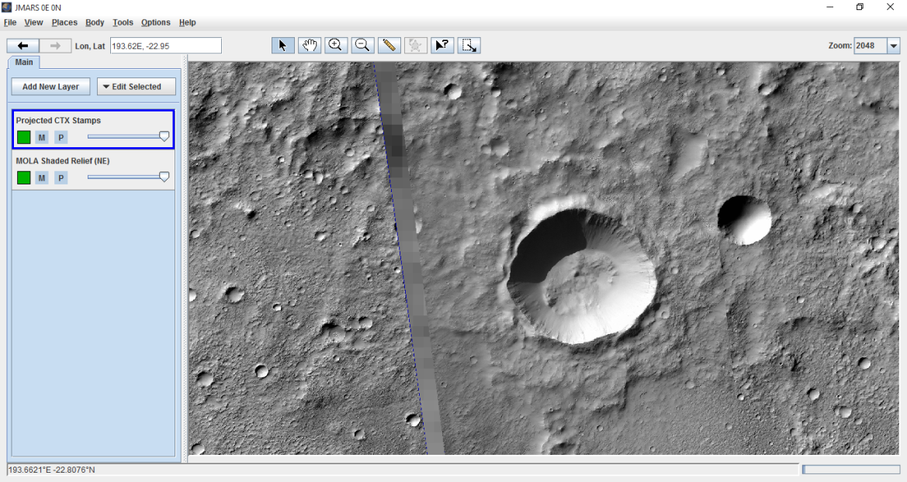
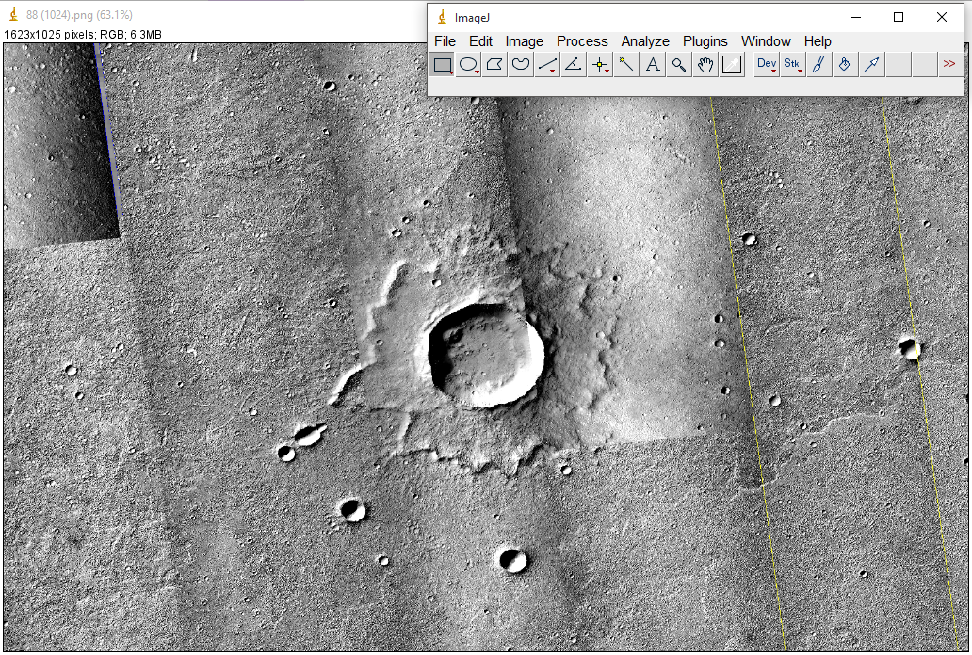
Software
ImageJ
Used to measure crater perimeter and area
JMars
Used to create crater mosaics.

Slide 7
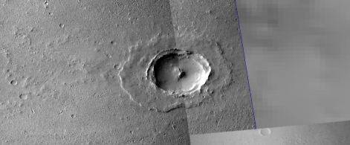
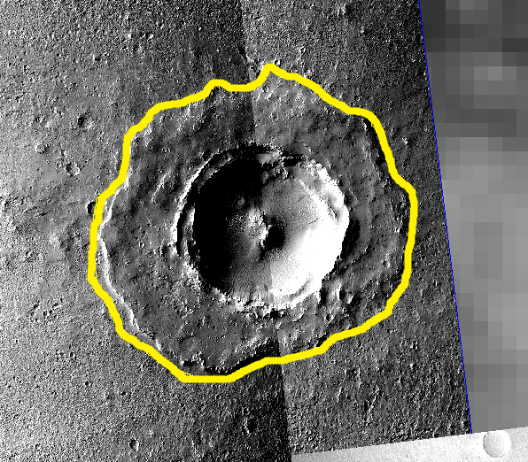
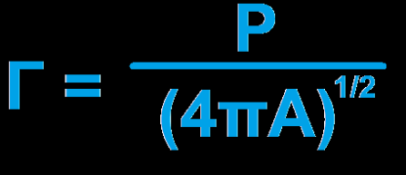
Data
Unmeasured
Measured
Lat/Lon: -0.59/181.69
Diameter: 5.0km
Area: 76.725 km²
Perimeter: 95.036 km
Av. EM: 0.97676
Lobateness: 3.06066
Notes:
All data is acquired through the JMARs program. Craters are assigned unique latitude and longitude values, and the crater diameters are measured via orbiting satellites. High resolution image strips are taken by the Context Camera (CTX) aboard the Mars Reconnaissance Orbiter, and these strips are overlaid to create image mosaics. The image mosaics are then used by the ImageJ program where the ejecta blanket is hand traced so that perimeter, area and lobateness can be calculated.

Slide 8
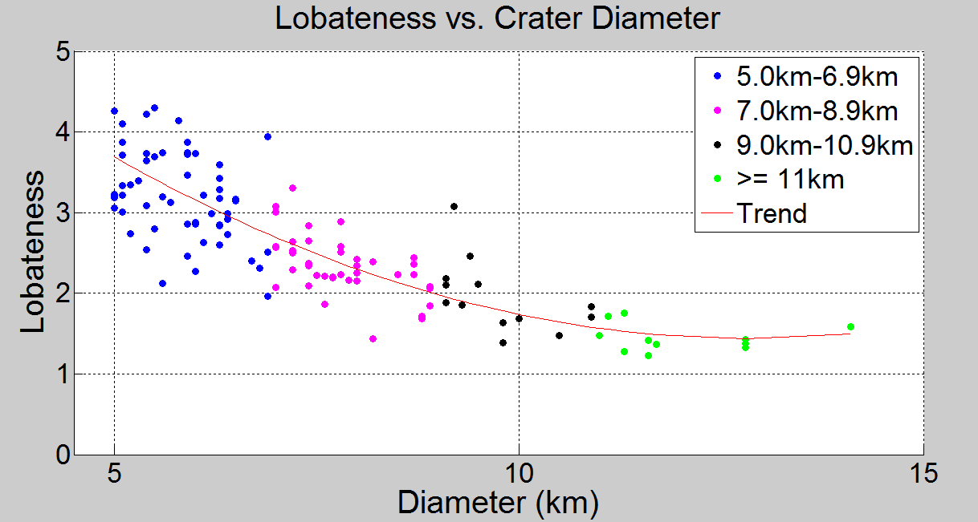
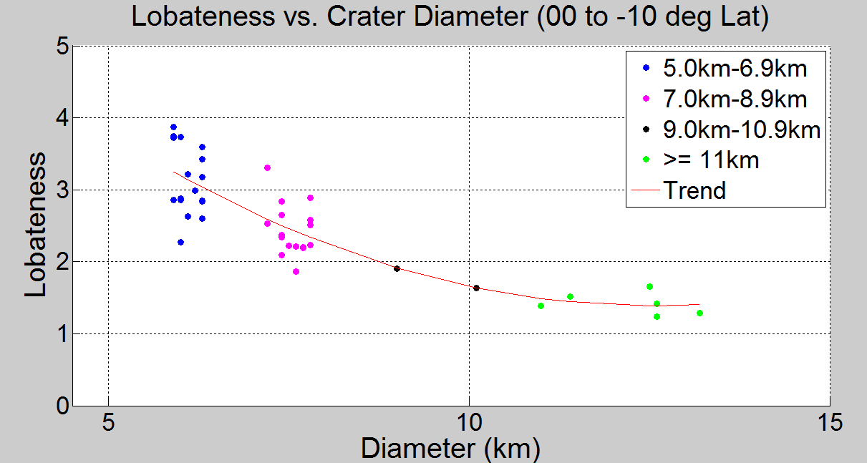
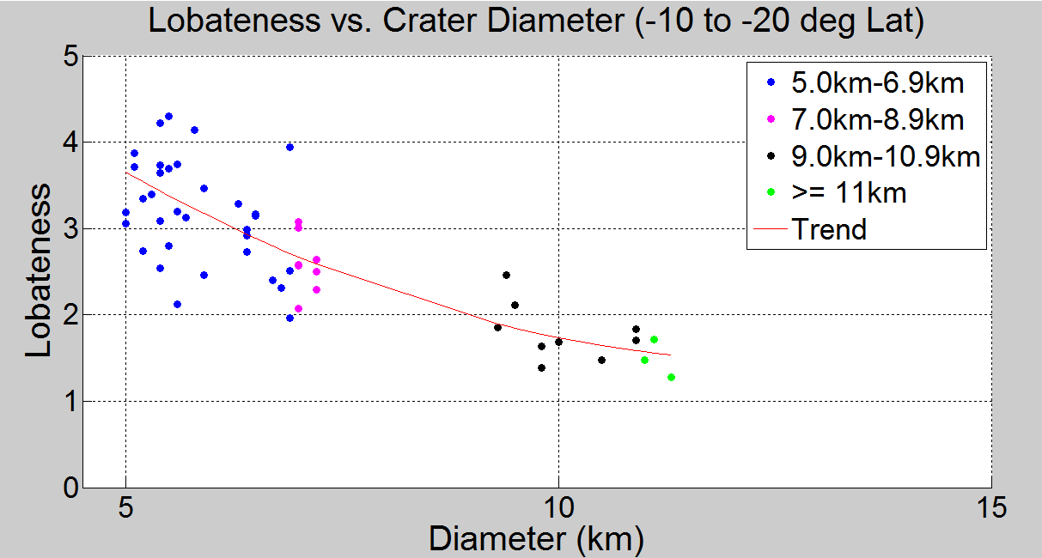
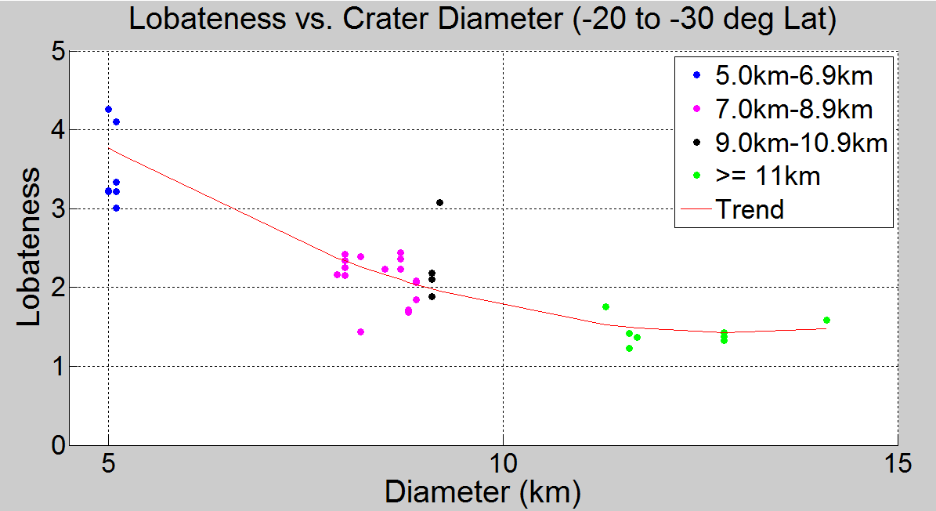
Analysis
All Crater Data
Craters 00-10s
Trend: y(x) = 7.469x² - 0.9382x + 0.0365
y(x) = 8.0134x² – 1.0554x + 0.0.0420
Craters 10s-20s
Craters 20s-30s
y(x) = 7.3814x² - 0.9277x + 0.0363
y(x) = 7.6363x² – 0.9577x + 0.0369
Notes:
A trend between crater diameter and lobateness is established when plotting all gathered crater data in the southern hemisphere. This trend is represented as parabolic equation, showing that as crater diameter increases, lobateness decreases. To see if this trend holds within a narrower range, craters are sorted to within segments of 10 degrees of latitude, and plotted together.

Slide 9
Conclusion
Parabolic between lobateness and crater diameter in Southern Hemisphere.
No obvious trends appear from the EM data.
North and South Hemisphere data need to be compared.
  Northern data are undergoing review at this time.
Notes:
While data in additional areas needs to be collected, of the two areas with a range of crater diameters, the trend holds.

Slide 10
Acknowledgements
Dr. Nadine Barlow
Kathleen Stigmon
NASA Space Grant
Northern Arizona University
Arizona State University/ JMars
Mars Reconnaissance Orbiter
ImageJ

Slide 11
Questions?

